Slide 1

Testing the Chronoly Projection Conjecture
Dick Bierman &
Jacob Jolij
University of Groningen

Slide 2
The Data
Meta-analyses of ‘presentiment’ studies
  physiological activity precedes apparent cause
  EEG preceding winning with the slot machine
Retroactive experiments (like Bem’s)
  behaviour precedes apparent cause
Main stream data re-analysis
  Damasio’s gambling experiment
  Groningen face detection paradigm

Slide 3
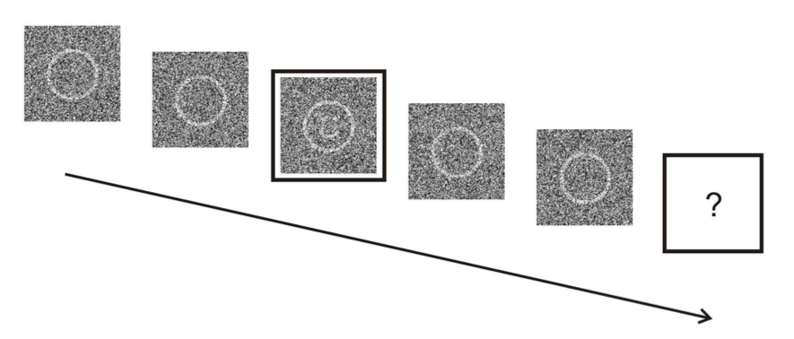
Groningen data
Face detection experiment
  2 random stimulus conditions: FACE & NOFACE
  Measuring EEG before, during and after stimulus
Several hundreds of trials
  One trial:
    1 key picture
    Embedded in noise
  two templates (vectors)
    One representing EEG before FACE
    One representing EEG before NOFACE

Slide 4
Analyses
Traditional
  Are these vectors different?
New analysis
  Can we predict the upcoming (random) stimulus
  Which template fits best to the actual EEG
  Use actual EEG BEFORE the stimulus-onset
  Templates use all the data except the data of the actual trial so this a post hoc analysis

Slide 5
Results of FACE/NOFACE predictions
STUDY | Nsubjects | Accuracy | t | es
Hypnosis | 27 | 52% | 2.4 | 0.93
Couples | 54 | 56% | 7.1 | 0.49
Coffee | 21 | 60% | 15.2 | 0.46

Slide 6
Theory
CIRTS Time-symmetry based (advanced solutions)
Does this imply retro-causation?
If so can we use the ‘info from future’
  to prevent the predicted future
  CIRTS: it is impossible to create paradoxes
  So let’s try it (in spite of Herbert’s warning)

Slide 7
Bilking experiment
Use the Face-NoFace paradigm
Use ad hoc prediction based upon fore measurement
IF Face is predicted the show no-Face
This creates in about 3-4% of the cases a paradox.
But it doesn’t allow presentiment analysis because the relation between EEG and stim condition is now algorithmic.

Slide 8
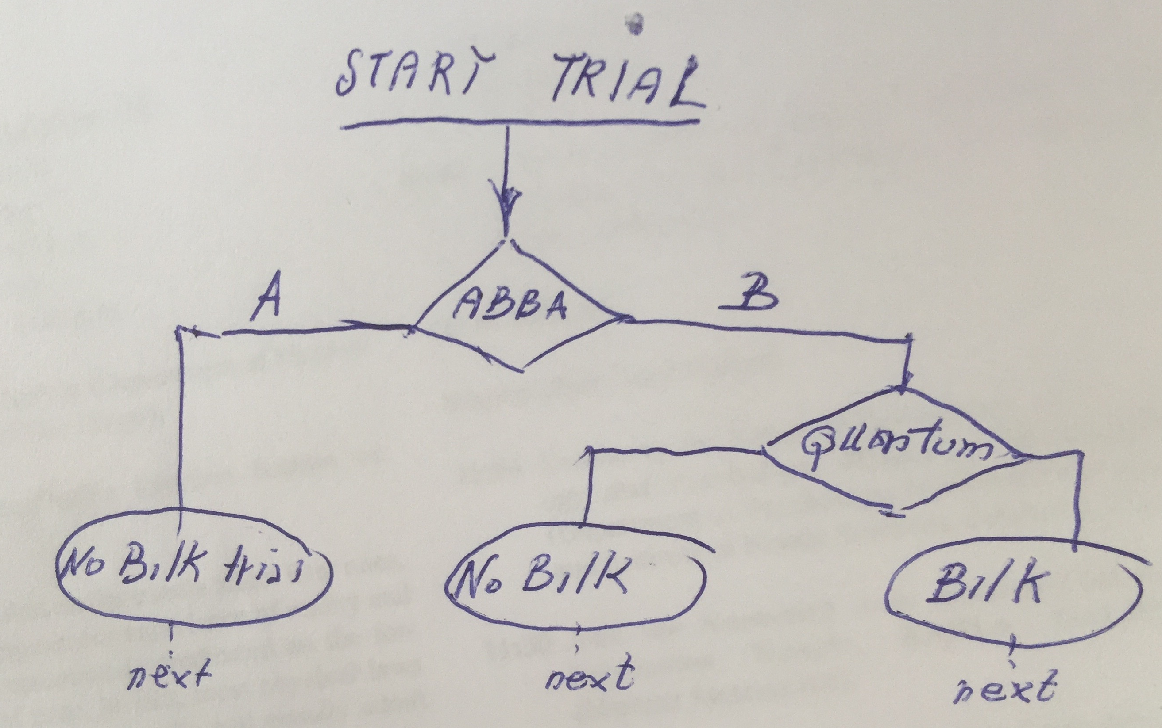
Here I need advice
What we have implemented

Slide 9
Preliminary Results
Only 2 subjects
  Show the same accuracy in the standard condition.
  No data yet for the bilking branch condition

Slide 10
Acknowledgement
The Heymansgroup at the University of Groningen

