Slide 1
The hidden secrets of Experimental Parapsychology
Prof. Dr Dick J Bierman, University Groningen, Heymansgroup.nl
Notes:
In experimental sciences we are not dealing with the truth but with increasingly better models. Better in terms of describing the observed phenomena and also better in terms of predicting outcomes of future experiments.

Slide 2
Synopsis
In this talk I will argue that the public presentation of Parapsychology, for instance in courses or talks like this one, is not reflecting what is actually known.
More specifically my argument is that the ‘secret’ features like poor replicability, declines, analyzer effects, psi experimenter effect, retro-PK etc. etc. are essential and by withholding these to the public, experimental parapsychologists have frustrated progress.
Notes:
But in order to participate in this process of improving our models of reality it is mandatory that ALL results, ALL data are taken into account.
In this talk will argue that the public presentation of Parapsychology, for instance in courses or talks like this one, is not reflecting what is actually known.
More specifically my argument is that the ‘secret’ features like poor replicability, declines, analyzer effects, psi experimenter effect, retro-PK etc. etc. are essential and by withholding these to the public, experimental parapsychologists have frustrated progress.
This message of course is not really directed at you as public but to the experimental parapsychologists. As such I am afraidthis talk will be a bit boring for the lay public. I apologize for that.

Slide 3
Public representation of experimental results
PSI is real
Proponents as well as skeptics never tell the dirty secrets
Proponents because they don’t want to complicate matters. (If you come out of this talk being totally confused my goal is reached ;-)
Skeptics because they generally are not driven by knowledge
Notes:
So what is wrong with the public representation of the field of experimental parapsychology.
Basically what is wrong can be expressed in one word: selection of data. This is a human property. People tend to select the data that support their prejudices. And if THEY are not doing this for themselves then Facebook will do it for them.
So we will find this tendency to selectively use data in proponents as well as in skeptic of experimental parapsychology.
Proponents as well as skeptics never tell the dirty secrets
Proponents because they don’t want to complicate matters. (If you come out of this talk being totally confused my goal is reached ;-)
Skeptics because they generally are not driven by knowledge

Slide 4
Proponents claim or assume
Psi phenomena are part of the objective real world…..
Notes:
Lets become more specific:
Prponents claim or assume that psi (or paranormal) phenomena are part of the objective real world. That is the way they present their data.

Slide 5
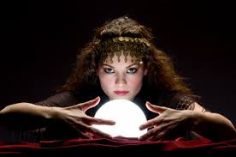
Objective Reality
Phenomena that observers can independently agree upon
For experimental (manipulative) science this means:
Phenomena that one can replicate.
Notes:
But what IS objective reality:
Phenomena that observers can independently agree upon
For experimental (manipulative) science this means:
Phenomena that one can replicate.
This should not be understood as that one must be able to demonstrate psi in the laboratory on demand.
It should be statistcally replicable

Slide 6
Replicability
If in earlier experiments there has been a effect (E) with some normal variation (V) one can calculate the probability distribution for future experimental outcomes depending on the number of subjects. One can also calculate the number of subjects required to get a significant result with a probability better than 1/100.
An effect is replicated if the new experimental result is not in statistical conflict with the distribution of outcomes predicted by the earlier measurement(s).
Notes:
So here is more precise definition:
If in earlier experiments there has been a effect (E) with some normal variation (V) one can calculate the probability distribution for future experimental outcomes depending on the number of subjects. One can also calculate the number of subjects required to get a significant result with a probability better than 1/100.
An effect is replicated if the new experimental result is not in statistical conflict with the distribution of outcomes predicted by the earlier measurement(s).
This is a rather relaxed definition because it allows for non significant results in a replication attempt without this being seen as a failed replication. Only when the new results STATISTICALLY contradict (differ significantly) from the previous ones it I a failed replication.

Slide 7
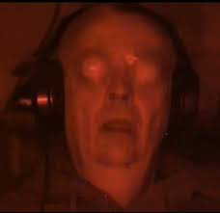
Is there replication?
Generally meta-analytic data are provided by proponents to claim replicability. A point in case: The Ganzfeld meta-analyses.
However we have shown that the results in these meta-analyses, under the assumption that parapsychologists are using similar research methods as psychologists, can be explained for over 50% by methodological weaknesses.
Bierman, D. J., Spottiswoode, J. P., & Bijl, A. (2016). Testing for Questionable Research Practices in a Meta-Analysis: An Example from Experimental Parapsychology. PloS one, 11(5)
Notes:
So the question now is: are psi results replicable in this sense
Generally meta-analytic data are provided by proponents to claim replicability. A point in case: The Ganzfeld meta-analyses.
The Ganzfeld database is an impressive set of over 100 experiments apparently showing an extremely significant effect with a probability that this is a chance result is smaller than 10^-16. I.e. 0.0000…01
However we have shown that the results in these meta-analyses, under the assumption that parapsychologists are using similar research methods as psychologists, can be explained for over 50% by methodological weaknesses.
This reduces that incredible small p-value to values in the range of 1 over 1000.
I won’t discuss all these methodological weaknesses here but they all boil down to post-hoc selection of data, Yes basically what I also observe when proponents are presenting their data to the general public.
Let me just give one example. This has to do with the exclusion of subjects.
Generally exclusion criteria are (or should be) set before the start of an experiment. For instance one can set an exclusion criterium that a subject has to communicate during Ganzfeld session. Suppose now that there has been a subject with 3 utterances during the 30 minute session. Suppose this subject scored a hit. But 3 utternce can be interpreted as a very low level of communication. The experimenter probably would have removed the subject if that subject had procuced a miss.
The problem here is that exclusion criteria are never precise and allow for biased application. In this case I would argue that the experimenter after the hit probaly doesn’t even think about removal of that subject. The Ganzfeld protocol is such that generally everybody in the lab knows tha result of the session of that day. Typicall hits re celebrated. This knowledge might introduce the selection bias.
So I don’t think the issue of replicability is settled

Slide 8
FIRST SECRET: replicability is poorer than suggested
We will show this later more concrete with an example of a specific type of experiment: Remote Viewing
If replicability is a condition for objective reality than we may doubt the objective reality of psi
Notes:
So meta-analytic data are presented evidence for replicability
What s not told is that claimed replicability doesn’t exist as I will show in a more concrete example of money making remote viewing.
We cannot exclude that non-replicability is a fundamental property of psi. In the standard interpretation of experimental sciences that just implies that these phenomena are not objectively real.

Slide 9
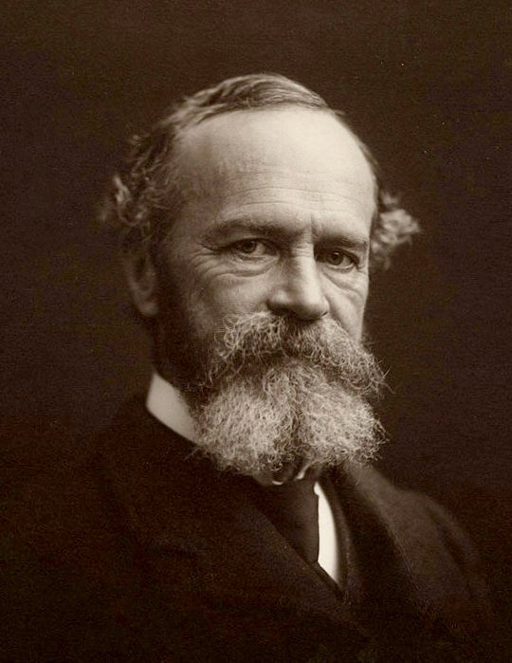
No replicability but Elusiveness
William James
All the ‘fathers’ of parapsychology have noted that the phenomena tend to change abruptly or disappear.
An example of elusiveness: we recently did an individual differences study and found all predictors to be reversed from earlier experiments.
Notes:
All the ‘fathers’ of parapsychology, such as for instance James, have noted that the phenomena tend to change abruptly or disappear the moment you think you get some control.. They labeled this ‘elusive’. Millar once compared the idea to ‘catch’ psi phenomena in the lab with trying to put universal solvent in a bottle! He suggests that elusiveness is a fundamental property of psi.
As an example of this elusiveness we recently did an individual differences study, personality differences related to psi performance, things like sheep-goat effects. Almost all predictors we found in this study were similar to the ones already known in the literature.
That sounds like replicability BUT the directions were all reversed Etc. found all predictors to be reversed from earlier experiments. : So sheep scored worse than goat etc.

Slide 10
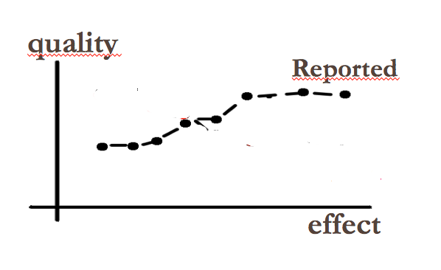
Proponents claim or assume
In most meta-analyses on experimental para-psychology like Psychokinesis and Presentiment the authors claim that the more significant results are of better quality experiments.
Notes:
I treated the issue of replicability first and most extensively because this is the core issue in experimental sciences. The following secrets will pass by faster.
The next one the role of quality assessment in science.
In most meta-analyses on experimental parapsychology like those on Psychokinesis and Presentiment, the authors claim that the more significant results are of better quality experiments.
This is of course to argue that the effects cannot be a consequence of sloppy research. HOWEVER

Slide 11
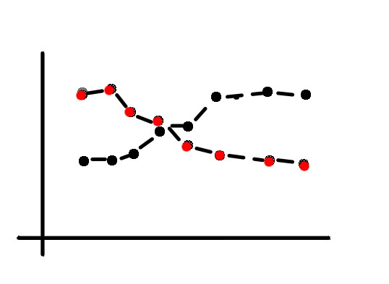
SECOND SECRET: False quality-effect relations reported
In most meta-analyses the authors claim that the more significant results are of better quality experiments.
Actually the non significant publicatons do REPORT less quality measures because why would one discuss alternative explanations if there is nothing to explain.
It cannot be excluded that if the quality asessment is more realistic, the best quality experiments have less significant outcomes suggesting that with perfect quality no psi is to be measured.
quality
Reported
True
effect
Notes:
There is a big problem in measuring the quality of research.
The authors use the publications to assess the quality of the research.
It is obvious that this doesn’t reflect true quality because written reports do not report everything.
And in the case of psi research the quality is generally assessed by checking if the experimenter did exclude NORMAL explanations for the anomalous results.
For instance in a PK study with dice it is important to check that the dice are behaving randomly if nobody is paying attention.
Soin the written report you will find extensive randomnesstest and the quality is then asessed as good. However as I said the idea here is to exclude alternative explanations. But if you have a non significant poutcome there is no need to exclude alternative expalanations and the report therefore will have no or less content relating to these checks. However if they don’t report a randomness test (and remember there is no need to report tho in nons studies) the whole experiment is rated lower in quality. WHILE THEY ARENT LOWER IN QUALITY. Actually the quality rating of non significant (short report) studies should be larger to reflect true quality.
It cannot be excluded that if the quality asessment is more realistic, the best quality experiments have less significant outcomes suggesting that with perfect quality is no psi is to be measured

Slide 12
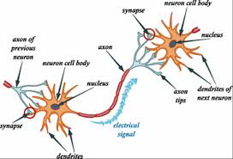
Proponents claim or assume
Psi effects can be modeled by some ‘signal’-transfer. By the spiritually inclined parapsychologist these ‘signals’ are labeled ‘non-local’. (Falsely borrowing a term from Quantum Physics)
Notes:
Let’s go to the next secret. This concerns the idea that psi is a kind of ‘signal’.
Psi effects can be modeled by some ‘signal’-transfer. By the spiritually inclined parapsychologist these ‘signals’ are labeled ‘non-local’. (Falsely borrowing a term from Quantum Physics). So telepathy is supposed to be a property of a ‘sender’ and a ‘receiver’.
First of all that model is crazy if we observe this from the framework of neuroscience.

Slide 13
Why this global model is crazy
Psi is a signal (or information transfer) that results in unexplainable correlations. The signal is obtained by the participant (also called ‘receiver’) by filtering that what is relevant for her.
BUT WHAT is being filtered?
Nearby and faraway, Past & present & future. !!!!!!!! ALL info in the cosmos.
Notes:
Psi is a signal (or information transfer) that results in unexplainable correlations.
The signal is obtained by the participant (also called ‘receiver’) by FILTERING that what is relevant for her.
BUT WHAT is being filtered?
Nearby and faraway, Past & present & future. !!!!!!!! ALL info in the cosmos.
Our brains cannot do that. It is just too much information.
But the signal model also implies more.

Slide 14
A replicable signal can be USED in a robust way
In precognitive RV experimenten (indirect) information about for instance a roulette is provided. Claimed Effectsize is E= 65% (MCE=50%). With the variation, V, expressed as the duration that the effect has gone before re-appearing.
We have shown by computer simulations that with this E and this V combined with a simple roulette betting scheme, the probability to earn a huge sum of money is larger than 80%. Only in 5% or less of the cases one runs out of money
However the psi researchers are always asking for outside financial support.
Notes:
Psi applications!
In precognitive RV experimenten (indirect) information about for instance a roulette is provided. Claimed Effectsize is E= 65% (MCE=50%). With the variation, V, expressed as the duration that the effect has gone before re-appearing.
We have shown by computer simulations that with this E and this V combined with a simple roulette betting scheme, the probability to earn a huge sum of money is larger than 80%. Only in 5% or less of the cases one runs out of money
The betting scheme is as follows. Use only 50% of the cash you have.
Stop once the money runs below 10 dollar.
Simple but apparently wrong because:
However the psi community is always asking for outside financial support.

Slide 15
THIRD SECRET: Psi can’t be used
It appears that effects generally evaporate once the effects are being used (for instance to make money)
Some of the spiritually inclined proponents respond that psi can only be used for the ‘good’ . In spite of reports on black magic.
But even without the explicit goal to use psi, the results tend to decline (and possibly incline again). The mysterious decline effect.
Notes:
So here is the third secret
It appears that effects generally evaporate once the effects are being used (for instance to make money)
Some of the spiritually inclined proponents respond that psi can only be used for the ‘good’ . In spite of reports on black magic.
But even without the explicit goal to use psi, the results tend to decline (and possibly incline again). The mysterious decline effect.

Slide 16
Further secrets
Experimenter Psi effects
Analyzer effects
Retro PK effects
Notes:
If a psi researcher is presenting evidence it may occur that the secrets are mentioned in passing. Or the secretshave been forgotten because even to the psi researcher those didn’t make sense.
Very often experimenter-effects are mentioned but in such a way that the audience is not alarmed but find them natural.
Analyzer effects as well as retro-PK effects seem to be forgotten in a large fraction of the psi researchers.
We will quickly treat those because I hope that if we combine all these secrets it will al fall into place.

Slide 17
Secret 4 The results are dependent of the Experimenter
Rosenthal effect
Experimenter brings about the best in the participant
Famous Schlitz Wiseman study (parallel studies)
Psi effect
The experimenter contributes as if (s)he is a participant
Millar claims that all results are experimenter effects
Notes:
Why experimenter effects are mentioned at times is because there is psychological theory that some researchers are better in handling subjects and better in bringing the subjects in the proper mood for showing psi effects. This has an equivalent in General Psychology and was introduced a long time ago by Rosenthal.
Rosenthal effect
Experimenter brings about the best in the participant
Famous Schlitz Wiseman study (parallel studies)
I should sketch what this study was all about. The two experimenters Schlitz and Wiseman decided to run a study in paralel,
Half of the subjects were handled by Wiseman and the other half by Schlitz. Schlitz got strong anomalous correlations in her data while Wiseman got nothing. (I am paraphrasing the results here for clarity)
Now we can understand this because Schlitz w2as a friendly eperimenter and Wiseman less so.
However the experimenter effects in psi research are of another order
Psi effect
The experimenter contributes DIRECTLY as if (s)he is a participant
Millar claims that all results are experimenter effects. Subject are of no relevance.
Millar argues here that basically the whole experiment including the subjects etc. can be seen as a random event generator. The experimenter is supposed to use PK to influence the outcome of the experiment. Experimenters are generally more motivated that unselected subjects.
But it can be even stranger……

Slide 18
Secret 5 The results are dependent on who is analyzing
Once all data are acquired the process of analysis starts
Generally the Analyzer = Experimenter and is not blind
Different analyzers produce different results
Even if the data are randomly split over analyzers.
Suggesting that Analyzer psi plays a role IN THE PAST
In the Schlitz-Wiseman experiment E = A
Refused to split the data randomly
Notes:
Little known, there have been a few experiments where the experimental data were split up and given to two independent persons to analyze. This has become known as the Edinburgh split.
(Once all data are acquired the process of analysis starts)
Often the Analyzer = Experimenter and is not blind
Different analyzers produce different results
Even if the data are randomly split over analyzers.
Suggesting that Analyzer psi plays a role IN THE PAST
In the Schlitz-Wiseman experiment E = A
Refused to split the data randomly

Slide 19
Secret 5 rephrased
Even when there is a manipulation after all data are recorded and in traditional perspective the experiment is finished, psi effects may have a retrocausal role.
The following and last secret is also interpretable as a retrocausal effect.
Notes:
Let’s slighty rephrase this finding in order to make sense of this.
Even when there is a manipulation after all data are recorded and in traditional perspective the experiment is finished, psi effects may have a retrocausal role.
The following and last secret is also interpretable as a retrocausal effect

Slide 20
SECRET 6: retro-PK is as good as real time PK
Psychokinesis was assessed meta-analytically by Radin and Nelson as objective reality
However it couldn’t be replicated in a large consortium effort by Princeton and German researchers (as we may have expected)
PK on prerecorded targets turns out to give at least as good results as real time PK suggesting the past can be changed,
But that is too scary to pay attention to, so retro-PK research is virtualy dead.
Notes:
Psychokinesis was assessed meta-analytically by Radin and Nelson as objective reality
However it couldn’t be replicated in a large consortium effort by Princeton and German researchers (as we may have expected)
PK on prerecorded targets turns out to give at least as good results as real time PK suggesting the past can be changed,
In this type of experiments a random process is recorded and stored.
Later sometimes a year later the random data are resented to a subject with the intention to influence the random processes (that were recorded in the past)
But that is too scary to pay attention to, so retro-PK research is virtualy dead.
Interestingly, retro-PK had been predicted by Walker on the basis of theoretical notions befre anybody had tried to run such an experiment.
What appears to a series of unrelated secrets now seems to show a pattern and what’s more there are at least 2 major theoretical models that would have predicted these secrets.

Slide 21
How to make sense of the secrets
Suppose psi is basically retro-causal
So for instance GESP is caused by retrocausal effects of the future feedback
Presentiment, precognition and retro-PK are of course retrocausal
Retrocausality (or time-travel) allows for paradoxes to occur
Dreaming of a future fire and then prevent it.
If nature wants to prevent paradoxes it may do so by making the results unstable, elusive, declining
Notes:
The analyzer effect as well as retro-PK but also old fashioned precogntion and the newer henomeon of presentiment all point into th directon that there is some intrinsic retro-causal aspect to psi.
But the apparent real-time phenomena of for instance clairvoyance can easily be expolained as a retrocausal effect of the future feedback
Retrocausality (or time-travel) allows for paradoxes to occur
Dreaming of a future fire and then prevent it.
If nature wants to prevent paradoxes it may do so by making the results unstable, elusive, declining
This is a core issue in CIRTS. But also the Model of Pragmatic information by von Lucadou and the Generalized quantum theory do predict that trying to use psi-correlations as a signal will annihilate them.

Slide 22
Conclusion
Most of the Secrets may be a product of the fundamental time-symmetry in Nature
By hiding secrets this incredible finding is also hidden
Definition of objective reality has to be adapted
Scientific modeling (so far ALWAYS causal) must be adjusted and possibly also some of the scientifc methods
It is to be expected that these conclusions are difficult to swallow by the academic community because they signify a scientifc revolution with far more impact than adding a 6th sense.
Notes:
Most of the Secrets may be a product of the fundamental time-symmetry in Nature
By hiding secrets this incredible finding is also hidden
Definition of objective reality has to be adapted
Scientific modelling (so far ALWAYS causal) must be adjusted and possibly also some of the scientific methods
It is to be expected that these conclusions are difficult to swallow by the academic community because they signify a scientific revolution with far more impact than adding a 6th sense.
In some sense what I have been talking about is a political issue. Information is always filtered and selected. We cannot avoid to do that when presenting scientific findings. One has to choose what to present and what to leave out. The tendency to present those findings that seem to fit in a simple sensory model rather tha to present also data that appear confusing, inconsistent and for many researchers are difficult to accept is another ‘selection’ decision. Which of the selection strategies is optimal in terms of raising interest in the global scientific community is difficult to assess. However as I hope to have shown presenting those data that don’t seem to fit at least suggest a unification of all psi phenomena through the underlying retro-causality.
Retro-causality by the way is an exponentially growing topic in physics. Before 2000 the number of physics papers on this topic was smaller than 5/yr while currently the number of pubs/yr is around 100. And it is still growing. Maybe that will lure my secretive colleagues to become more communicative about the hidden secrets of experimental parapsychology.
I hope all this was not too boring and thank you for your attention.

