Slide 1
Can results in ‘experimental Parapsychology’ be accounted for by ‘questionable research practices’?
Dick J Bierman, James P. Spottiswoode & Aron Bijl
Notes:
Answer at the end but let’s first introduce parapsychology and QRP’s

Slide 2
Is Telepathy/Clairvoyance a real phenomenon?
Impossible (prior = 0)
Certainly (prior = 1)
Maybe…… so
  TEST IT with a card guessing experiment
    Rhine, Heymans ~ 1935
Notes:
We don’t want to be religuous about this so So let’s test it. Rhine 1935 , Heymans (Groningen) BBC Horizon 1983!!!!!

Slide 3

BBC Horizon 1983 example of clairvoyance run

Slide 4
Results
For this run alone: p < 0.006
Seems odd that with such results the question is not decided yet.
These forced choice experiments were replaced by ‘free response’ experiment.
Notes:
Apparently this was not a real experiment

Slide 5
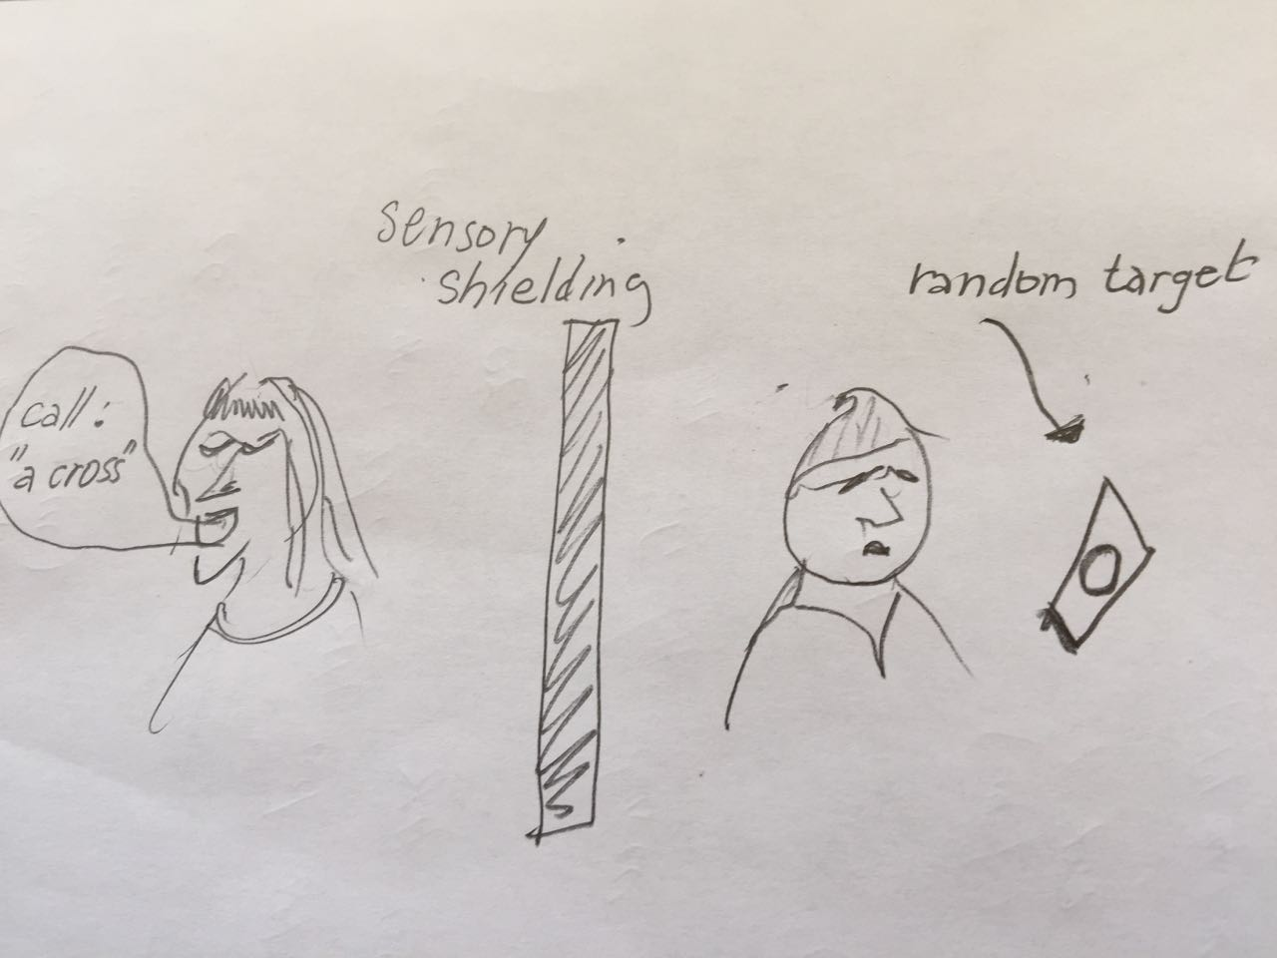
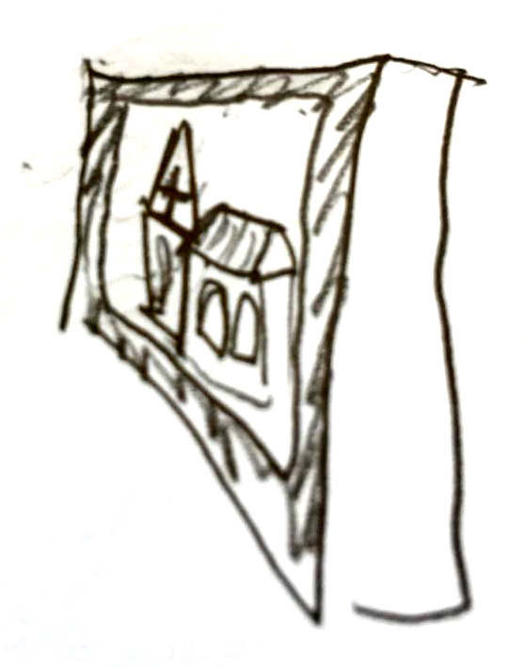
General set-up telepathy
Receiver
Sender
Free response
Notes:
Forced choice -> Free response; lets look at early dream research experiment followed by the Ganzfeld which is the further focus of this talk

Slide 6
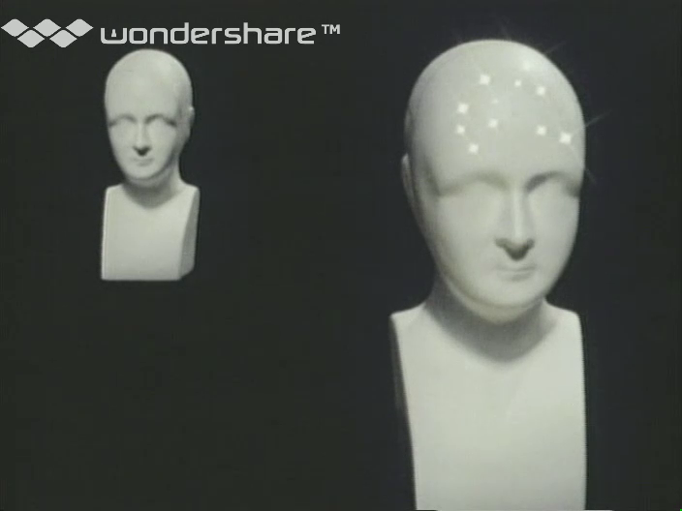
Free response Ganzfeld telepathy

Slide 7
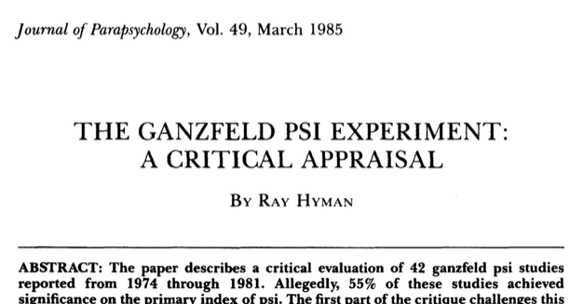
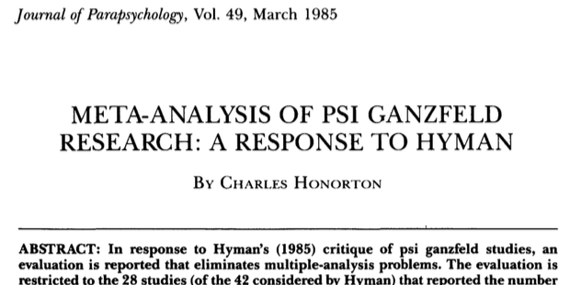
Early meta-analysis
Multiple indices
controversy
Notes:
Two persons from the video 1975- 1985 around 35 studies allowing for a review

Slide 8
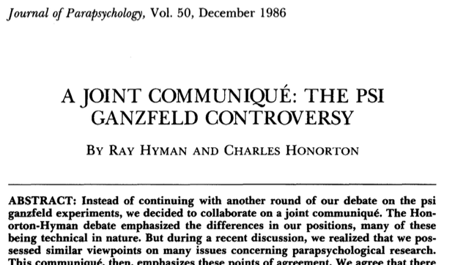
Joint communiqué
A plea for pre-registration!!!!
Notes:
They did not call it preregistration but the EJP did implement it for a number of years. Not enough authors submitted their plans

Slide 9
How to answer the primary question
Get the best evidential MA database
Simulate GF experiments like those in the database but assuming no-telepathy
Simulate for each experiment the effect of QRP’s
Are the results of these simulations similar to the experimental results?
Notes:
Primary question was in other words: are parapsychologists fooling themselves

Slide 10
The Ganzfeld MA database
This database is considered by most psi proponents to be the best evidence.
From Storm et al (2010):
  ……The homogeneous database consists of 102 studies: mean z= 0.81 (SD =1.23; range: 􏰂2.30 to 4.32), ……, and Stouffer Z = 8.13 (p = 10⁻¹⁶). ….. With Rosenthal’s (1995, p. 189) file- drawer formula, there would have to be approximately 2,414 unpublished and non-significant papers in existence to reduce our significant Stouffer Z to chance…….
Notes:
Outrageous number of unpublished versus published (given the fact that non-s studies were also published)

Slide 11
The GF database reduced
First Augmented with 6 outliers that Storm removed to get homogeneity (6)
Then remove all pre-1985 studies (27)
Then remove 2 studies by Sargent to account for the QRP of deception.
Result: 79 studies with a single dependent variable, the hit rate. (MCE = 25%)
  e.g. Murre et al (1988, hit rate 32%)
  E.g. Bierman et al (1993, hit rate 26%)
Notes:
No reasons to exclude outliers (on both sides 3)

Slide 12
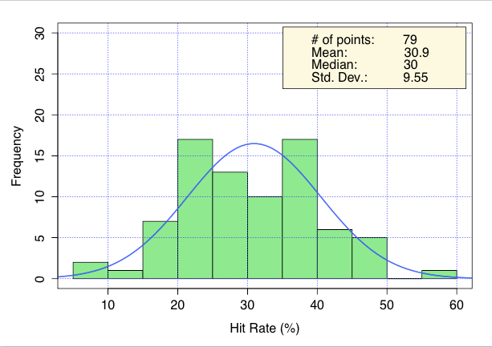
Sample size distribution

Slide 13
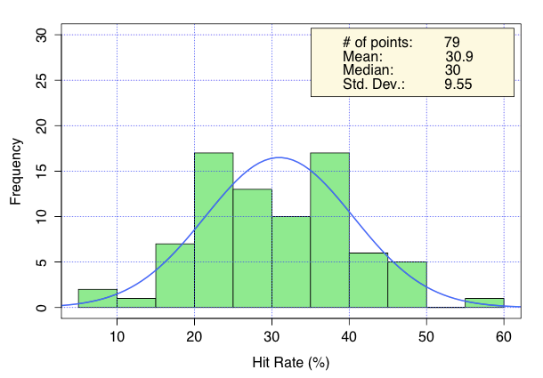
Distribution of hit-rates
Notes:
Note the mean hit rate of 31% compared with 25% MCE

Slide 14
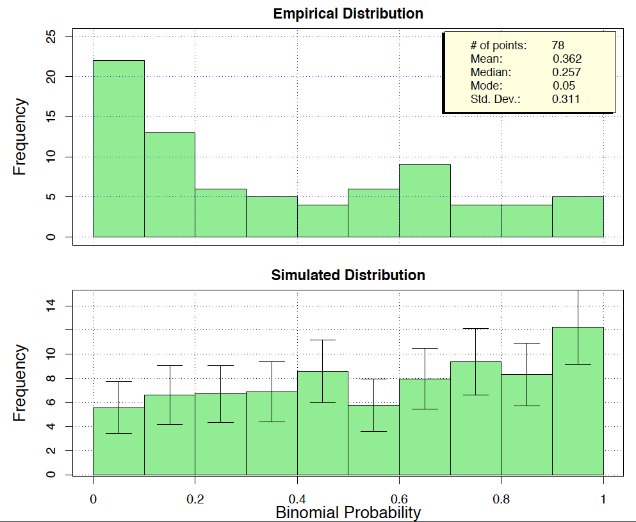
Distribution of p-values
Can we, by adding QRP’s to the lower distribution, get the upper one.
Notes:
Note the high frequency of p<0.01 and low above p=0.07

Slide 15
Sample size versus effect size
Notes:
We fit this too because in the larger database the negative correlation is significant/

Slide 16
QRP’s
Some QRP’s from the literature are not applicable ( e.g. multiple indices)
Deception (estimated prevalence ~1%) is taken care off by removing Sargent.
Most other QRP’s are considered more or less acceptable by exp. psychologists.
Notes:
Another unimplemented (and not mentioned in QRP literature = hand scoring (~1% with large variations depending on context). Sargent - Eysenck

Slide 17
Implemented QRP’s
1. Confirmation to Pilot (C2P)
2. Pilot to Confirmation (P2C)
3. Optional Stopping (OS)
4. Optional Extension (OE)
5. Publication Bias (PB)
6. Biased removal of Subjects (rmSs)

Slide 18
QRP Parameter specs
Notes:
We did first run simulations per QRP with each QRP prevalence =100%. Surprisingly OS didn’t do anything to the hitrates (minor effect on p-value distribution)

Slide 19
Method: simulations
Use empirical sample size distribution
1 cycle = Simulation of one unit of 79
Yields a fitting value per cycle of simulated data versus actual empirical data
Fitting parameter is sum of Z², chi2 distributed with df= between 2 and 3 (due to non orthogonality of components of the fitting parameter).
Notes:
Using many cycles allows us to estimate the distribution of the 4 components of the fitting value

Slide 20
Method 2
Rather than trying out different QRP parameters in different combinations by hand we let the computer search for the best fit by searching through the free parameter space.

Slide 21
Method: optimal fit by GA
Free parameters describing the QRP’s are represented as a chromosome.
Each generation has 60 chromosomes
Variation is like genetic combinations in breeding/evolution, adding a small random component (avoiding suboptimal solutions).
Stop breeding if nothing improves in 30 generations.
Notes:
GA are nowadays standard for fitting purposes i.e. cosmological problems (fittinf cosmic background radiation distribution to string theoretical predictions

Slide 22
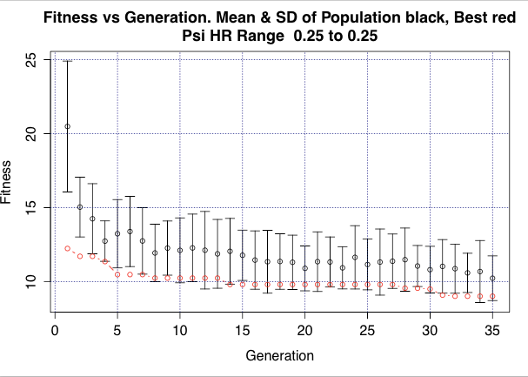
Fitness versus Generation
Notes:
Note the apparent jump from one sub-optimum to the next. In the unconstrained solution one gets an reasonable F of 5 but the prevalences are way higher than in the literature and the FD is way too large as well as the number of removed subjects.

Slide 23
Constraints to prevalences
(using John et al, 2012)
QRP | Prevalence John | Realistic prevalence
CtoP | 22.5 | 20-50
PtoC | - | 20-50
OS | 22.5 | 20-50
OE | 58 | 40-60
PB | 50 | 40-60
rmSs | 43 | 35-55

Slide 24
Results 1
It is not possible to get a good fit (F= 11.0) using realistic values of the QRP parameters this is caused by the discrepancy between the simulated and actual mean hit rates (Z= ~3, p<<0.01)
The fit with regard to p-value distribution and negative sample-size vs effect-size correlation is very good.
Publication Bias estimated by GA is ~50% unpublished finished studies.
0.7 removed subjects per study
Notes:
Reasonable except for hit rate. So we also allowed the true psi hit rate to bee a free parameter (25 being no telepathy)

Slide 25
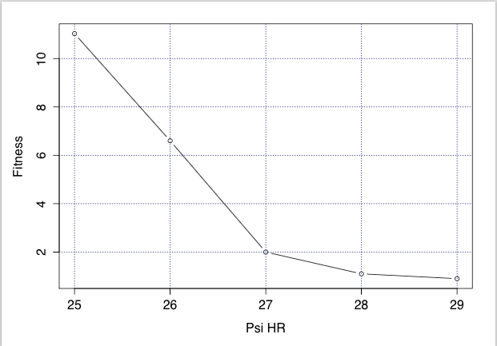
Results 2 (adding a psi component)
Fitness vs Simulated true Psi effect
No significant difference between simulation and experimental

Slide 26
Conclusion 1
This method shows that parapsychologists almost certainly ‘fooled themselves’ with respect to claimed effect sizes. So the power is much lower than hitherto assumed and to get 80% power one needs hundreds of trials (rather than the 44 they did on average)
The method can also be applied to other (controversial) MA databases.
Notes:
This conclusion may be altered if we could find other QRP’s so anyone having an idea please contact me.

Slide 27
Conclusion 2
If this kind of Quantitative evaluation of the effect of QRP’s can be made, the ‘dirty test tube’ rejection of results is unethical. There is an obligation to show what the quantitative effect of the dirty test tube is.
Preregistration of secondary analyses like these is required in order to avoid over-analysis.

Slide 28

Questions?
This research is unsponsored and didn’t cost the taxpayer a dime

