Slide 1
Parapsychology
Dick Bierman
University of Amsterdam
d.j.bierman@uniamsterdam.nl
17 april 2012, Brein & Cognitie , Universiteit van Amsterdam

Slide 2
The Phenomena
Telepathy
  E.g. phone-telepathy
Clairvoyance
  E.g. Dunne’s dream
Precognition/sentiment
  E.g. 9-11
Psychokinese
  E.g. Poltergeist
Notes:
Space & Time transcendent

Slide 3
Paranormal ‘Explanation’
Mental Radio (extra sensory perception)
  Selectivity problem !!!!!!
Mental distance control (PK)
Precognition ?????
This model has misguided research

Slide 4
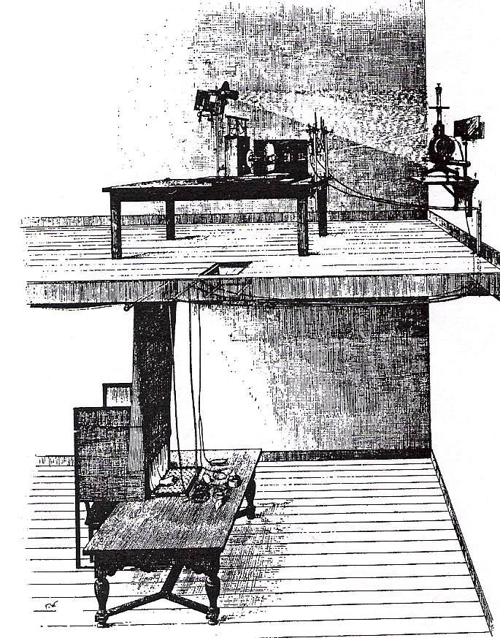
Normal Explanation
Coincidence
Selective memory
False memories
Cheating
So controlled lab-research
  Rhine (card guessing), Heymans
  E.g. phone-telepathy

Slide 5
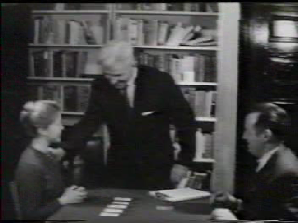
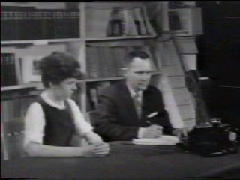
Quantitative research 1930-1960
Telepathy clairvoyance
Psychokinesis

Slide 6

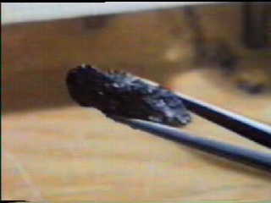
Quantitative research 1960-1980
Telepathy clairvoyance
Psychokinesis

Slide 7
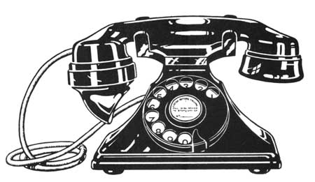

Onderzoekspracticum UvA
6 proefpersonen met elk vier bellers
Alle bellers zijn goede vrienden van de proefpersoon
Proefleider bezoekt proefpersoon thuis tijdens de zitting om fraude uit te sluiten
Proefpersoon noemt naam van random beller voor het opnemen van de telefoon (p=0.25)
Correlatie met Locale Sterrentijd (Local Sidereal Time (LST))

Slide 8
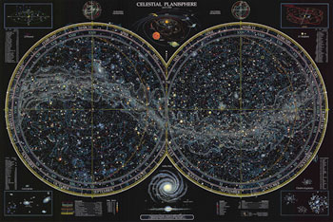
Local Sidereal Time (LST)

Slide 9
Local Sidereal Time (LST)
Onderzoek van Spottiswoode (1997)
Effectgrootte bij onderzoek naar paranormale verschijnselen
Effecten hangen samen met LST
Piektijd is rond 13.30 LST

Slide 10
Onderzoeksopzet
Zittingen vinden plaats op twee tijdstippen, piektijd (13.30 LST) en niet-piek tijd (00.00 LST)
Twee proefleiders: een bij de proefpersoon thuis, een elders met een dobbelsteen
Elke proefpersoon wordt 18 keer tijdens piektijd gebeld en 18 keer tijdens niet-piektijd

Slide 11
Resultaten telefoontelepathie

Slide 12
Probleem
Sommige bellers blijken niet bereikbaar tijdens de zittingen.
  Daardoor zijn er eigenlijk maar drie bellers
  Als de proefpersoon hiervan weet, is de kans groter dat zij goed raadt
Oplossing:
  Nogmaals de analyse doen met alleen de correct verlopen zittingen

Slide 13
Resultaten telefoontelepathie
(alleen correct verlopen zittingen)

Slide 14
Unification (Dunne revisited)
Telepathy = Clairvoyance =
Precognition of feedback=
TIME ‘reversal’
• Psychokinesis = decrease entropy =
second law in thermodynamics
but with reversed ‘TIME’.

Slide 15
Advantages of unified model
Selectivity problem Solved
Integration with main stream
  Intuition research -> presentiment
  Cognitive research -> retroactive paradigms
    Retroactive habituation
    Retroactive priming
    Retroactive interference
  Main stream but manipulation after measurement.

Slide 16
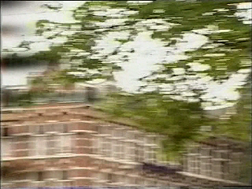
Presentiment research
Random (roulette like) future conditions
Physiology preceding the manipulation.

Slide 17
Intuition research
Bechara, A., Damasio, H., Tranel, D., & Damasio, A. R. (1997). Deciding advantageously before knowing the advantageous strategy. Science, 275, 1293-1295.

Slide 18
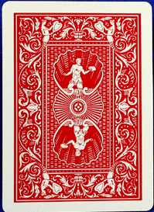
Gambling
IOWA Gambling task. Take a card from one of 4 decks. Cards can be loosing or winning (the amount of $$ you win or loose is on the other side of the card).

Slide 19
Damasio’s IOWA gambling procedure
Participants get initially $2000
They take a card from 1 of 4 decks.Two are bad decks.
Skin Conductance is recorded and averaged separately for the trials in which the subject choose a card from good decks vs trials where subject choose a card from the bad decks
Draws card
Feedback: win or loss
Skin Conductance
Preparation
time
Notes:
In the Damasio experiment the procedure is different. The subjects do not sit in front of a screen but in front of 4 decks of cards. Two of those decks are risky decks and loose in the long run and two decks are advantageous in the long riun. So the subject is requested to take a card from one of the decks and to determine which strategy is the best. Note that the time before they take the card is variable unlike in the presentiment experiments.

Slide 20
Results for healthy subjects
Subjects take more often from good decks while thinking they are just guessing, they learn the good decks. (IMPLICIT LEARNING)
Before the subjects explicitly formulate the difference between the decks of cards, their body already ‘knows’. This is indicated by larger skin conductance before taking from a bad deck.(SOMATIC MARKER)
There is criticism on the experiments and the interpretation. Nonetheless Intuition seem to be driven by past information.

Slide 21
Damasio’s Somatic Marker model
PAST (impl. learning)
PRESENT (biased selection)
Previous problem and decision (selection of alternative)
Current similar problem
Actual decision
Good or Bad outcome
NC Reduction of
Alternatives
Somatic Marking
Of Decision

Slide 22
Integration with presentiment
PAST (impl. learning)
PRESENT (biased selection)
Previous problem and decision (selection of alternative)
Current similar problem
Actual decision
Good or Bad outcome
NC Reduction of
Alternatives
Somatic Marking
Of Decision

Slide 23
Driven by the future outcome?
PAST
PRESENT
FUTURE
Past outcomes
Actual decision
Future outcome
Somatic
Marker
Physiological
Response
????????
Presentiment

Slide 24
Pre-sentiment in IOWA Gambling task?
How do we measure presentiment:
Anticipation of a random event (feedback)
Two potential outcomes
One good, one bad
But wait a moment.......
There are winning and loosing cards in all the decks!
So: Do not average SC over bad en good decks but over the winning and loosing cards within the decks!

Slide 25
Skin Conductance in gambling task split for Winning & Loosing cards
Win or loose is random (future) condition
Response larger for loss
Anticipation is 20% larger for future loss!
Feedback: win or loss
Draws card
Preparation
Loss
Win
time

Slide 26
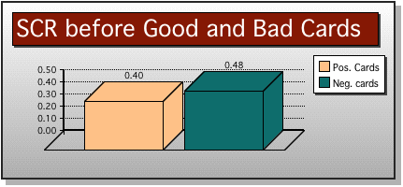
CARD!-analysis Damasio’s Gambling experiment
t = 1.634; df=117 ; p =0.053
• Presentiment effect : 20%!
Notes:
Although it is impossible to know which card will come up it appears that the body knew too and we see a presentiment effect here too! Let’s now have a look at the last experiment.

Slide 27
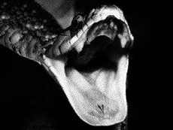
Animal Fear Study (1999)
Globisch, J., Hamm, A.O., Estevez, F., and Ehman, A. (1999). Psychophysiology, 36, pp. 66-75.
7 sec
150 msec
6850 msec
Fixation stimulus
Blank Screen
Skin Conductance
response
anticipation
time
Notes:
Here is the procedure of one trial in the experiment intended to find out how fast fear would arise in phobic subjects
This german group measured skin conductancene of a subject in front of screen when
When the subject pressed …..
Many trials were done where randomly either emotional or neutral visual stimuli were presented in this study.

Slide 28
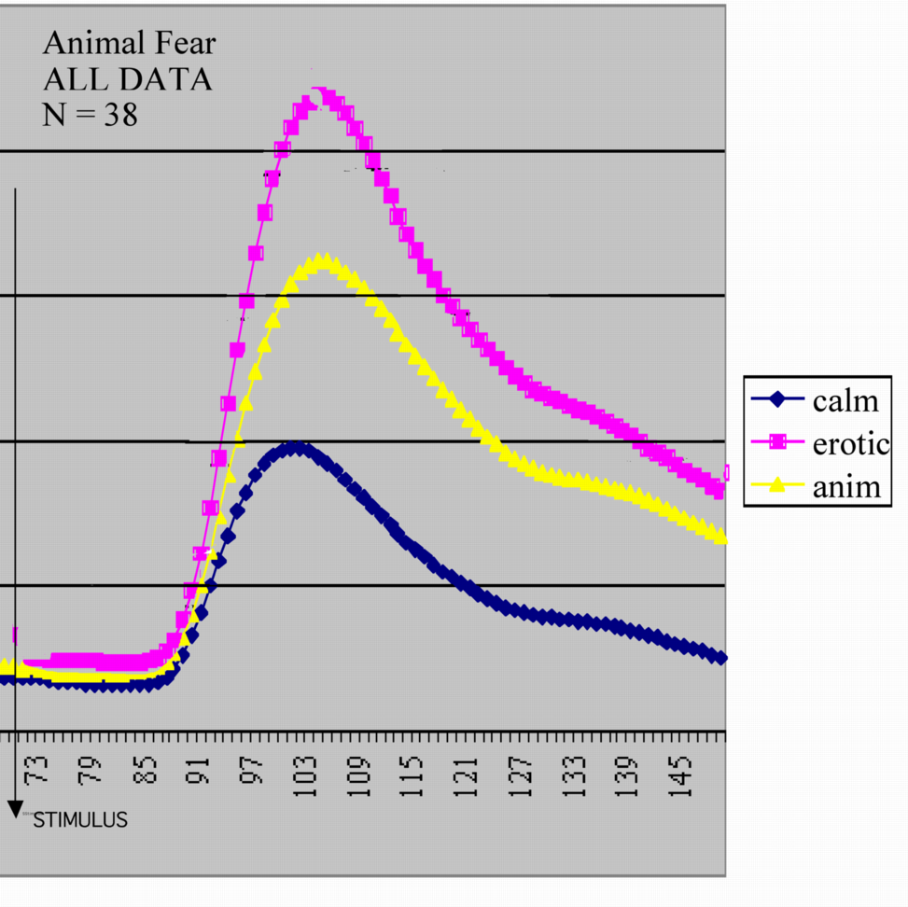
Published Results
Erotic
Baseline had been set at stimulus-onset
All signals are clamped to 0 there.
Calm
Notes:
Here are the results of all 38 subjects as they were published. In this picture all baseline levels are clamped to 0 at stimulus onset.
The german groups allowed us to re-analyze the raw data but this timeincluding the anticipatory phase of the trials I.e. what happened BEFORE the stimulus was presented.
Rather than clamping the baseline at 0 at stimulus onset we therefore clamped the baselines at 7.5 seconds before stimulus onset. And here is the result

Slide 29
Results re-analysis raw data
Erotic
Baseline set at -7 seconds
Anomaly
Calm
stimulus
Notes:
There are three plots because the emotional pictures are split for animals and erotic pictures. The yellow trace is for the animal pictures and the results given here are all data (phobics group plus control group). Note that the difference between the erotic responses and the other responses already starts before stimulus onset while the subjects have no way to know or guess what kind of stimulus will be presented. This was labeled presentiment.
Of course there are individual differences……

Slide 30
Presentiment variables
• Dependent Variables
  Skin Conductance
  HR
  EEG, CNV
  BOLD
  Blinks, pupil dilation, eye movement
Independent Variables
  Pictures, sounds, shocks, slotmachine

Slide 31
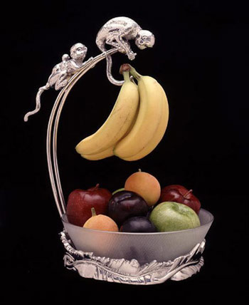
Banana Banana Apple
Results in EEG different from resulting from Banana, Banana, Banana

Slide 32
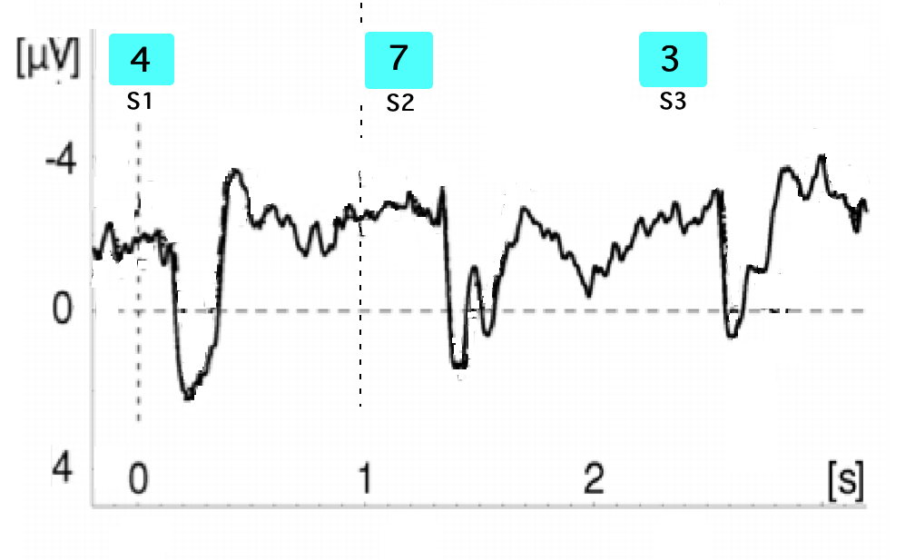
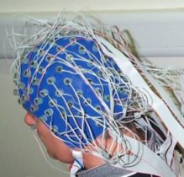
FEPS5 2003
KUB
Donkers, FCL & Boxtel, GJM Van (2005)
Mediofrontal negativities to averted Gains and Losses in the Slot-Machine Task.
Journal of Psychophysiology, 19 (4)
`
4
7
3

Slide 33
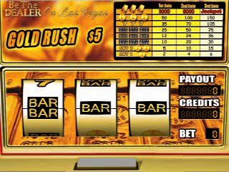
SLOT MACHINE

Slide 34
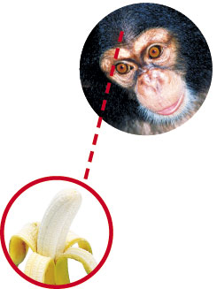
Method
32 Volunteers
128 trials
Each trial: participant pays 0.50 euro
XXX gives 7 REAL euro (p=12.5%)
Random with replacement
Focus on medio frontal electrodes (Fz, Pz, Cz)
Preprocessing identical to Donkers et al

Slide 35
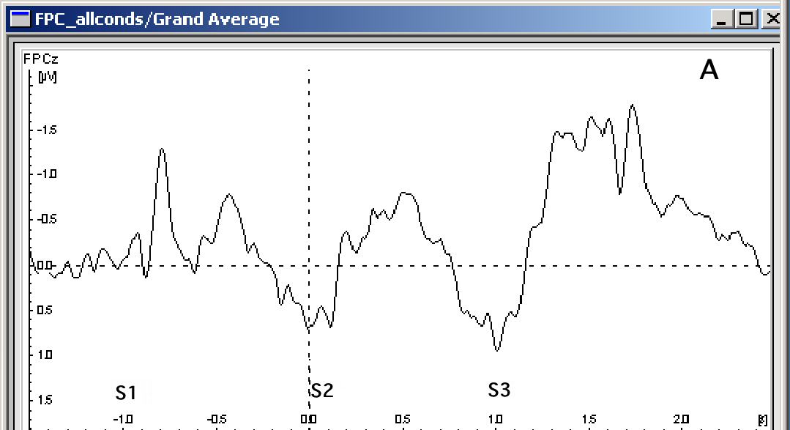
Overal result (pooled over XXY & XXX)
1 participant: no usable data

Slide 36
Statistics
S3
Gemiddeld verschil XXX-XXY in S2-S3 interval: 1.88 microV
(t= 2.35 , df=30, p = 0.026)

Slide 37
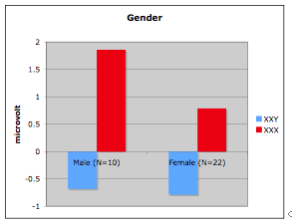
Gender?

Slide 38
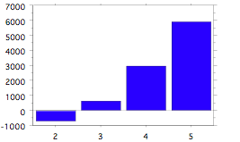
Relation with attention of participant
Effect in microvolts (*1000)
Self-rated attention

Slide 39
Relation with ‘Luckiness’

Slide 40
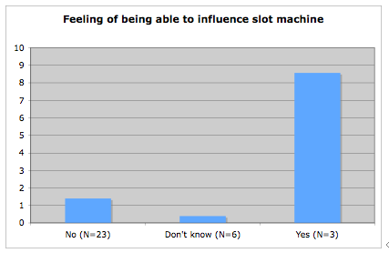
Special subjects

Slide 41
But difficult to replicate
Only special subjects? Could they feel their EEG?
Replication is an important issue

Slide 42
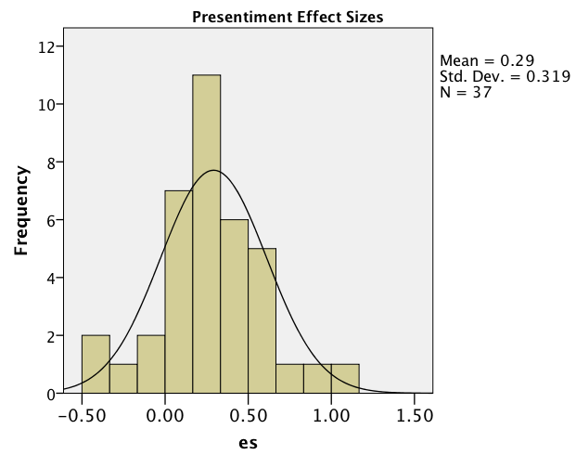
Presentiment Meta-analysis
37 studies, 15 different main authors
Mean effect size: 0.29
Combined p <10^-9
Filedrawer fail safe: 670
Gambler’s fallacy
Mossbridge et al (2011). In press.

Slide 43
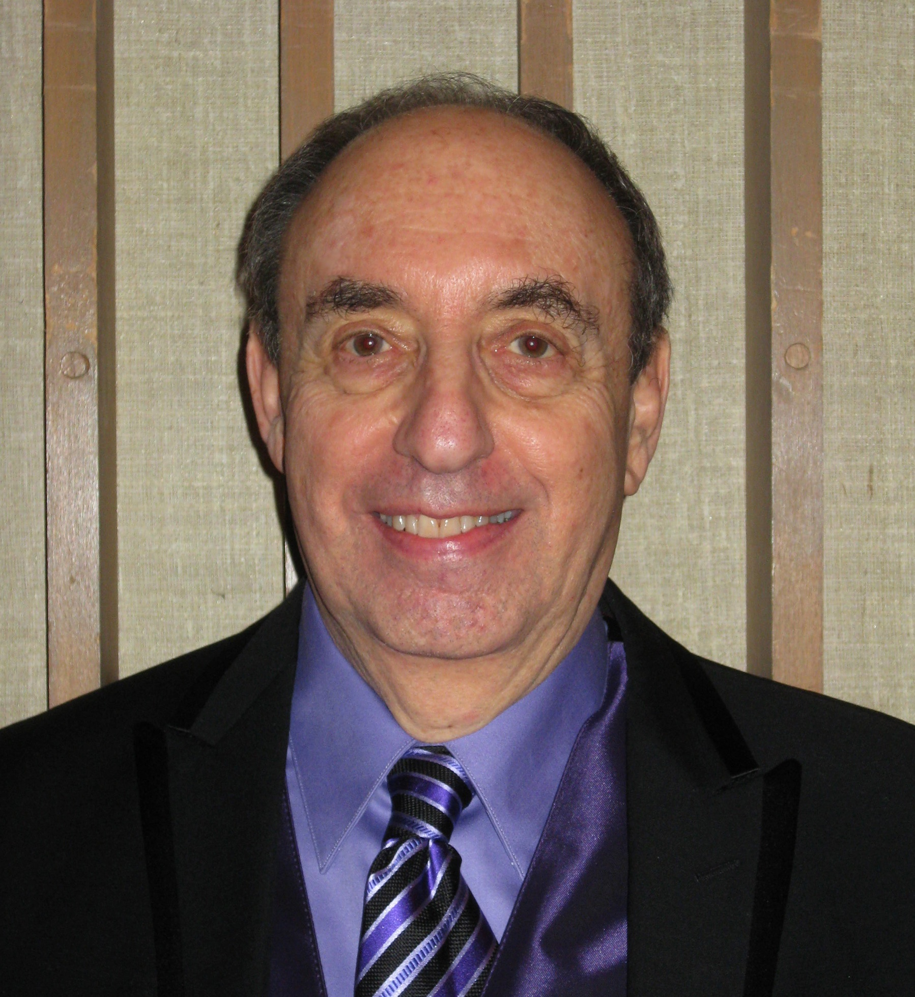
Bem’s cognitive approach
Cognitive measures
  No physiology because of global replication
Reversed standard Psychological Paradigms
  Manipulation after the measurement
    Decision making
    Habituation
    Affective Priming
    Retroactive memory facilitation

Slide 44
Procedure retroactive facilitation of recall
3. Practice exercise
2.Surprise Free
Recall
Carpenter
To which category belongs
To which category belongs
1.Visualize words
…........................
Carpenter
Random subsample
of words

Slide 45
Results Bem studies
Improved recall performance on words that got later extra exercise.
Results Retroactive Facilitation of Memory
  (N=150) mean effect size: 0.30 (p<0.01)
Results all 9 studies
  All Bem studies mean effect size: 0.22 (p<10^-10)

Slide 46
Criticism
Statistical
  Using Bayesian stats the null hypothesis is still to be preferred (Wagenmakers et al, 2011)…..
  Over-analyses are not corrected for….
  Combination of experimental results is not allowed….
Theoretical
  Temporal Causality violation is not allowed……

Slide 47
Necker Cube study: retroactive interference
Bierman, D.J. (2011). Anomalous Switching of the Bi-Stable Percept of a Necker Cube: A Preliminary Study. JSE, 25-3, pp. 771-783.

Slide 48
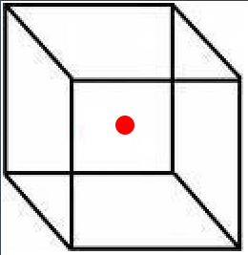
The Necker Cube experiment
Change randomly into
opaque
Top or Bottom view
interference
Top view is experienced
Top view duration
time
Second
button press
when experience switches
First
button press
Notes:
The subject has to wait for some time. He might experiene a few switches from topview to bottomview and vice versa. Then at some point the subject has to press a button when a switch from bottom to top view occurs. And then he has to press the button again when the next switching back occurs. So what we measure is the time that the top view is experienced.
And now comes the manipulation. As soon as we know this duration of the top view perspective we present a non transparent view of the cube. Randomly the top view or the bottom view.
According to normal causality this manipulation should have no effect on the already measured top view duration.

Slide 49
Retroactive interference Results
Followed by:
(difference = 129, p<0.03)
N=153
Effectsize = 0.17

Slide 50
Results

Slide 51
Theory
Consciousness Induced restoration of Time Symmetry (CIRTS)
    Maxwell EM theory: set of equations
    Plug in 1: Initial conditions
    Plug in 2: Boundary conditions
    RESULT: Retarded solution and Advanced solution
    But not observed in physical systems
      Feyman & Wheeler: Cosmological Boundary Condition
Bierman, D.J. (2010) CIRTS, a psychophysical theoretical perspective, JoP, 74, pp. 273-299)

Slide 52
Special Boundary condition
Information processed by brains sustaining consciousness.
Individual differences ~ brain coherence?
  ‘Supported’ by larger effects by meditators

Slide 53
Replication issues
Psi phenomena are notoriously difficult to replicate
Traditionally ’explained’ by psychological variables (large uncontrolled variance)
and Experimenter effect
But maybe intrinsic???????

Slide 54
The paradoxes
Formally Retro-Causality equivalent with backward time travel.
But that results in……. ‘grandfather like’ paradoxes
  Source of event is destroyed.
  Perfect and detailed precognitive dream that your house will burn down tomorrow………

Slide 55
Avoiding paradoxes
From Wikipedia, the free encyclopedia:
The Novikov self-consistency principle, also known as the Novikov self-consistency conjecture, is a principle developed by Russian physicist Igor Dmitriyevich Novikov in the mid-1980s to solve the problem of paradoxes in time travel, which is theoretically permitted in certain solutions of general relativity (solutions containing what are known as closed timelike curves). Stated simply, the Novikov consistency principle asserts that if an event exists that would give rise to a paradox, or to any "change" to the past whatsoever, then the probability of that event is zero. In short, it says that it's impossible to create time paradoxes

Slide 56
Take home messages
Parapsychology develops into para-physics with ‘retrocausality’ as key topic. Experimental paradigms are from psychology.
Physics does not exclude ‘advanced’ effects
Retrocausality implies restrictions in replication.
Sequential replication might intrinsically becoming more and more difficult.
Role of (neuro) psychology: Individual differences (Brain coherence?). Context variables

